Slide 1
Introduction to Bioinformatics (BIO310)
Afraz Ahmad Raja

Slide 2
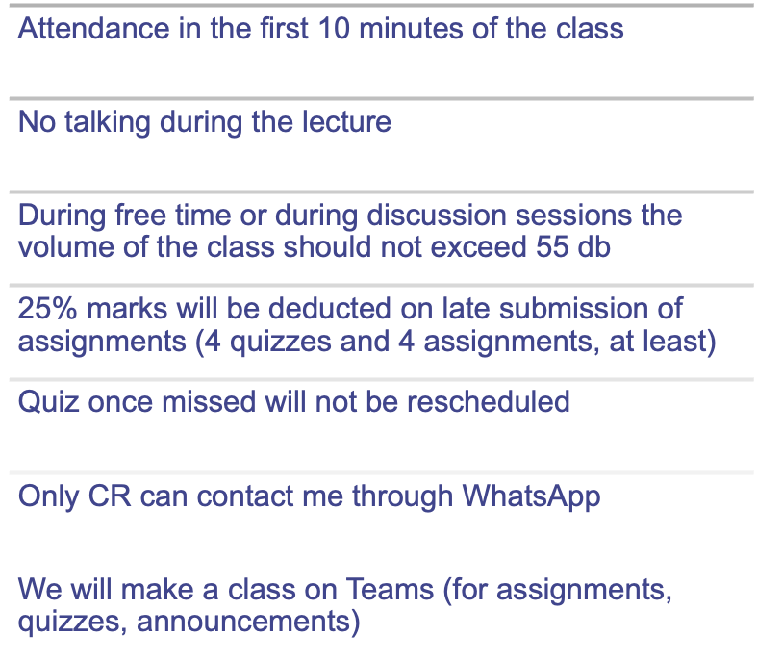
Rules of The Class

Slide 3
Course Contents
Introduction to Bioinformatics
Key concepts of Biology and Computers in Bioinformatics related to DNA, RNA, Nucleotides, Amino Acids, Proteins, Protein-Protein Interaction
Databases and Web Resources
Algorithms
Dot Matrix, Dynamic Programming for local and global pair wise alignment using Smith-Waterman and Needle-Wunsch algorithms, gap penalties including Affine gap penalty, Scoring and Substitution Matrices (PAM & BLOSUM), Multiple Sequence Alignment, BLAST and FASTA, etc
Phylogenetics

Slide 4
Labwork for Tomorrow (Assignment)
When was the last time you studied Biology? Or Genetics? Or Molecular Biology?
What is DNA?
What are Proteins?
When you read the word Bioinformatics, what the first thing that comes to your mind?
What do you want to learn from this course?

Slide 5
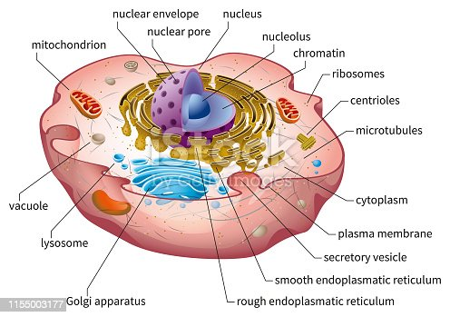
The Human Cell

Slide 6
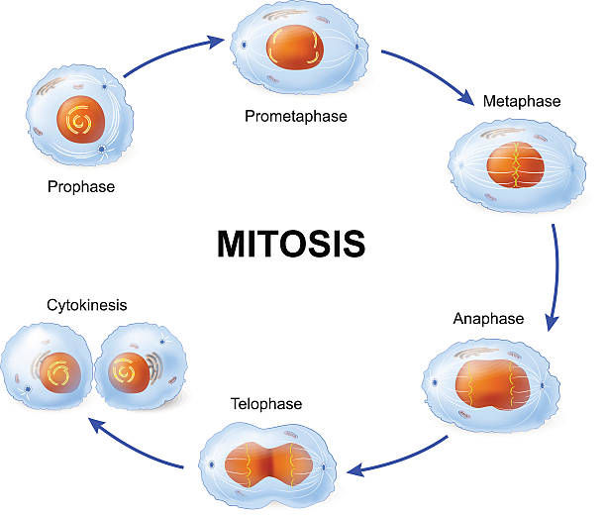
Cell Division

Slide 7
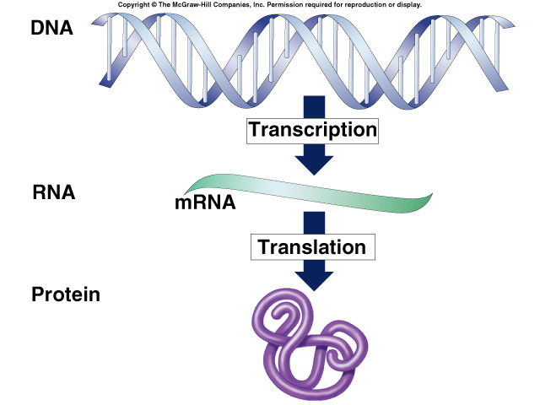
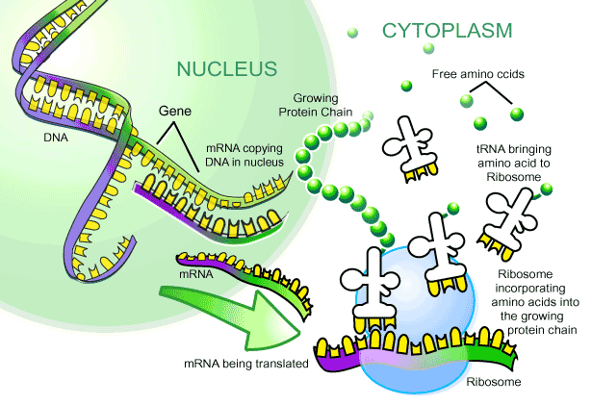
From Gene
to Protein
How Genes
Work

Slide 8
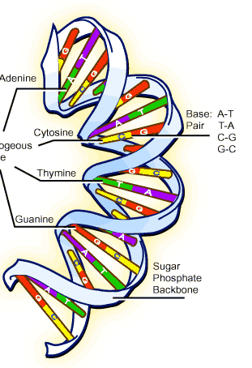
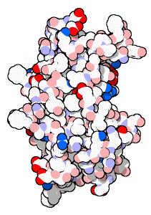
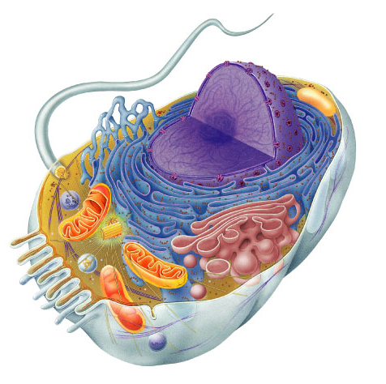

What Do Genes Code for?
How does DNA code for cells & bodies?
  how are cells and bodies made from the instructions in DNA
DNA
proteins
cells
bodies

Slide 9
The “Central Dogma”
Flow of genetic information in a cell
  How do we move information from DNA to proteins?
transcription
translation
DNA
RNA
protein
trait
DNA gets
all the glory,
but proteins do
all the work!
replication
Notes:
To get from the chemical language of DNA to the chemical language of proteins requires 2 major stages:
transcription and translation

Slide 10
Metabolism taught us about genes
Inheritance of metabolic diseases
  suggested that genes coded for enzymes
  each disease (phenotype) is caused by non-functional gene product
    lack of an enzyme
    PKU (phenylketonuria)
Am I just the
sum of my proteins?
metabolic pathway
disease
disease
disease
disease
A
B
C
D
E
✗
✗
✗
✗
enzyme 1
enzyme 2
enzyme 3
enzyme 4

Slide 11
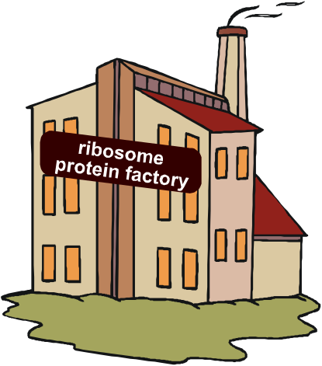
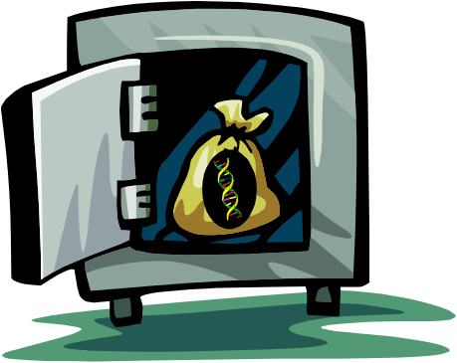
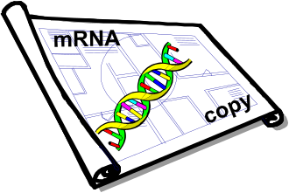
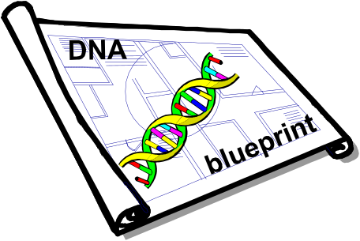
From gene to protein
aa
aa
nucleus
cytoplasm
aa
aa
aa
aa
transcription
translation
aa
DNA
mRNA
protein
aa
aa
aa
aa
ribosome
trait

Slide 12
Transcription
from
DNA nucleic acid language
to
RNA nucleic acid language
2007-2008

Slide 13
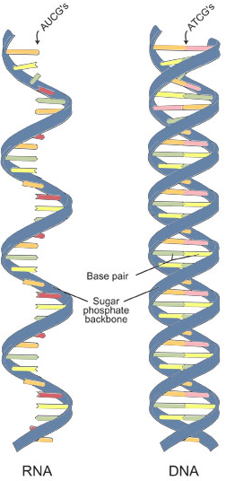
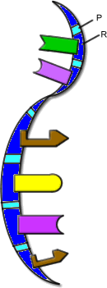
RNA
ribose sugar
N-bases
  uracil instead of thymine
  U : A
  C : G
single stranded
lots of RNAs
  mRNA, tRNA, rRNA, siRNA…
transcription
DNA
RNA

Slide 14
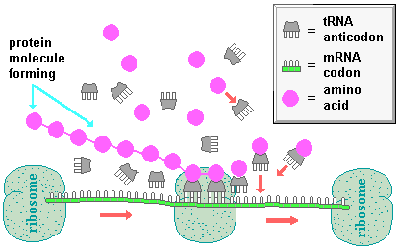
3 KINDS OF RNA HELP WITH INFO TRANSFER FOR PROTEIN SYNTHESIS
RIBOSOMAL RNA (rRNA)
Made in nucleolus
2 subunits (large & small)
Combine with proteins to
form ribosomes
Bacterial ribosomes different
size than eukaryotic ribosomes
Medically significant-some antibiotics target
bacterial ribosomes w/o harming host
rRNA and t-RNA images from Image from: Biology; Miller and Levine; Pearson Education publishing as Prentice Hall; 2006
mRNA image from http://wps.prenhall.com/wps/media/tmp/labeling/1140654_dyn.gif

Slide 15
3 KINDS OF RNA HELP WITH INFO TRANSFER FOR PROTEIN SYNTHESIS
TRANSFER RNA (tRNA)
ANTICODON sequence
matches CODON on mRNA
to add correct
amino acids during
protein synthesis
AMINOACYL-tRNA SYNTHETASE
Enzyme attaches a specific
amino acid using energy from ATP
http://www-math.mit.edu/~lippert/18.417/lectures/01_Intro/

Slide 16
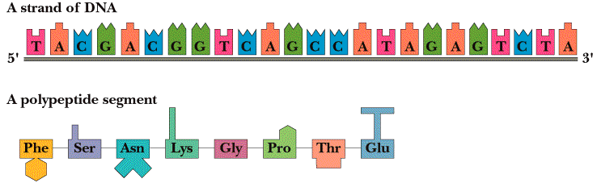
3 KINDS OF RNA HELP WITH INFO TRANSFER FOR PROTEIN SYNTHESIS
MESSENGER RNA (mRNA)
carries code from DNA to ribosomes

Slide 17
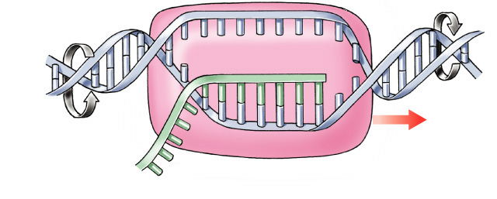
Transcription
Transcription
Making mRNA
  transcribed DNA strand = template strand
  untranscribed DNA strand = coding strand
    same sequence as RNA
  synthesis of complementary RNA strand
    transcription bubble
  enzyme
    RNA polymerase
coding strand
3′
5′
A
G
A
G
C
A
T
C
G
T
A
A
A
G
T
T
C
T
C
A
T
C
C
A
G
T
DNA
G
A
T
3′
A
C
T
5′
T
G
G
C
A
U
C
G
U
T
3′
C
G
T
A
G
C
A
unwinding
rewinding
mRNA
RNA polymerase
template strand
build RNA 5′→3′
5′

Slide 18
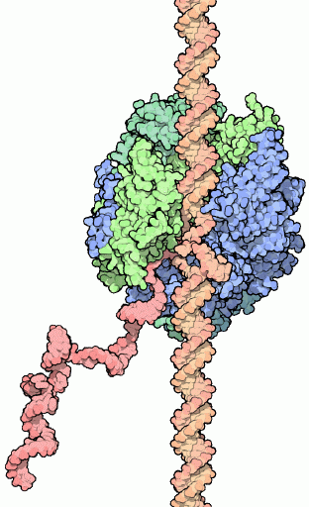
RNA polymerases
3 RNA polymerase enzymes
  RNA polymerase 1
    only transcribes rRNA genes
    makes ribosomes
  RNA polymerase 2
    transcribes genes into mRNA
  RNA polymerase 3
    only transcribes tRNA genes
  each has a specific promoter sequence it recognizes

Slide 19
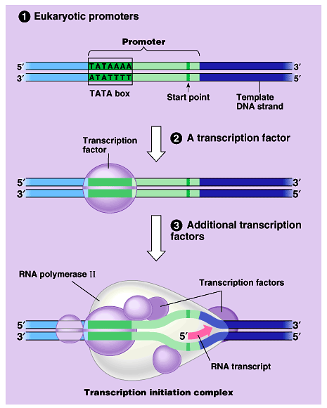
Which gene is read?
Promoter region
  binding site before beginning of gene
  TATA box binding site
  binding site for RNA polymerase
  & transcription
  factors
Enhancer region
  binding site far
  upstream of gene
    turns transcription
    on HIGH

Slide 20
Transcription Factors
Transcription
Initiation complex
  transcription factors bind to promoter region
    suite of proteins which bind to DNA
    turn on or off transcription
  trigger the binding of RNA polymerase to DNA

Slide 21
Matching bases of DNA & RNA
A
Match RNA bases to DNA bases on one of the DNA strands
C
G
U
G
A
U
G
U
C
U
C
G
A
A
C
U
A
G
A
C
U
5'
A
3'
RNA
polymerase
G
A
C
C
T
G
G
T
A
C
A
G
C
T
A
G
T
C
A
T
C
G
T
A
C
C
G
T

Slide 22
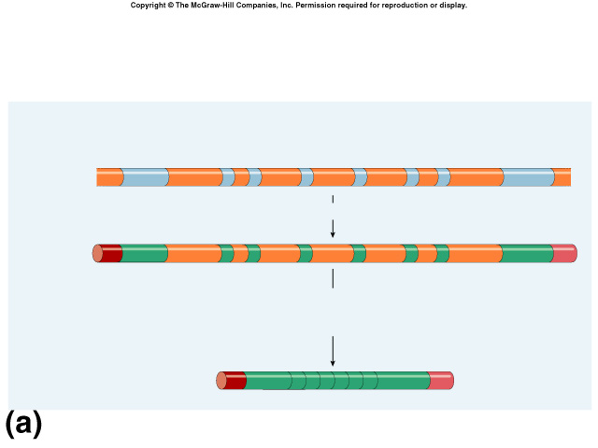
Eukaryotic genes have junk!
Eukaryotic genes are not continuous
  exons = the real gene
    expressed / coding DNA
  introns = the junk
    inbetween sequence
introns
come out!
intron = noncoding (inbetween) sequence
eukaryotic DNA
exon = coding (expressed) sequence

Slide 23
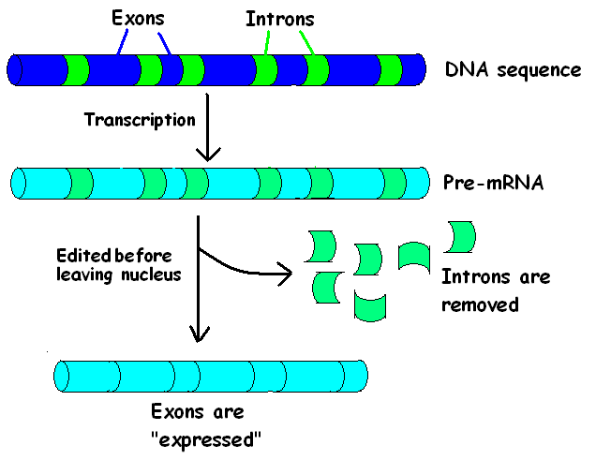
mRNA’s require EDITING before use
Message in NOT CONTINUOUS
INTRONS are removed
Image by Riedell

Slide 24
mRNA splicing
Post-transcriptional processing
  eukaryotic mRNA needs work after transcription
  primary transcript = pre-mRNA
  mRNA splicing
    edit out introns
  make mature mRNA transcript
intron = noncoding (inbetween) sequence
~10,000 bases
eukaryotic DNA
exon = coding (expressed) sequence
pre-mRNA
primary mRNA
transcript
~1,000 bases
mature mRNA
transcript
spliced mRNA
Notes:
eukaryotic RNA is about 10% of eukaryotic gene.

Slide 25
Splicing must be accurate
No room for mistakes!
  a single base added or lost throws off the reading frame
AUGCGGCTATGGGUCCGAUAAGGGCCAU
AUGCGGUCCGAUAAGGGCCAU
AUG|CGG|UCC|GAU|AAG|GGC|CAU
Met|Arg|Ser|Asp|Lys|Gly|His
AUGCGGCTATGGGUCCGAUAAGGGCCAU
AUGCGGGUCCGAUAAGGGCCAU
AUG|CGG|GUC|CGA|UAA|GGG|CCA|U
Met|Arg|Val|Arg|STOP|

Slide 26
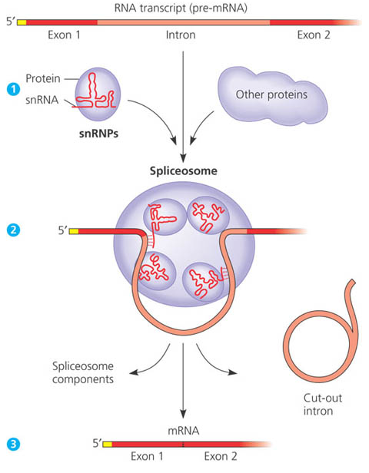
mRNA EDITING
PROCESSING RNA
SPLICEOSOMES
ALL ENZYMES ARE PROTEINS?
RIBOZYMES-RNA molecules
that function as enzymes
(In some organisms pre-RNA
can remove its own introns)

Slide 27
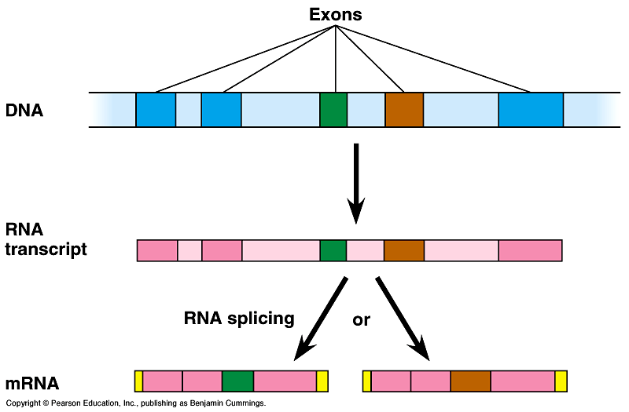
Alternative splicing
Alternative mRNAs produced from same gene
  when is an intron not an intron…
  different segments treated as exons
Starting to get
hard to
define a gene!

Slide 28
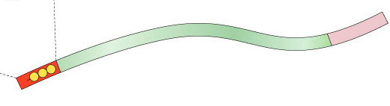
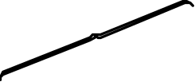
More post-transcriptional processing
Need to protect mRNA on its trip from nucleus to cytoplasm
  enzymes in cytoplasm attack mRNA
    protect the ends of the molecule
    add 5′ GTP cap
    add poly-A tail
      longer tail, mRNA lasts longer: produces more protein
3' poly-A tail
3'
A
A
A
A
A
mRNA
50-250 A’s
5' cap
P
P
P
5'
G
Notes:
eukaryotic RNA is about 10% of eukaryotic gene.

Slide 29
From gene to protein
aa
aa
nucleus
cytoplasm
aa
aa
aa
aa
transcription
translation
aa
DNA
mRNA
protein
aa
aa
aa
aa
ribosome
trait

Slide 30
Translation
from
nucleic acid language
to
amino acid language
2007-2008

Slide 31
How does mRNA code for proteins?
DNA
TACGCACATTTACGTACGCGG
4
ATCG
mRNA
AUGCGUGUAAAUGCAUGCGCC
4
AUCG
?
protein
Met Arg Val Asn Ala Cys Ala
20
How can you code for 20 amino acids with only 4 nucleotide bases (A,U,G,C)?

Slide 32
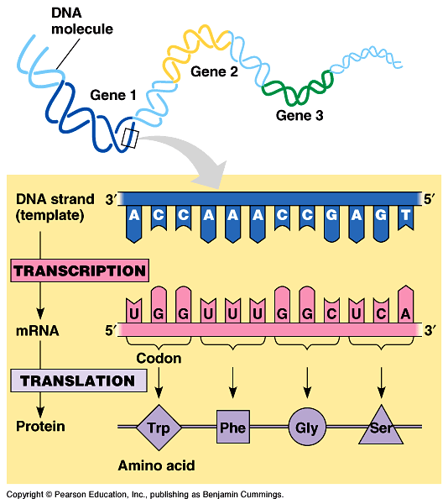
mRNA codes for proteins in triplets
DNA
TACGCACATTTACGTACGCGG
codon
AUGCGUGUAAAUGCAUGCGCC
mRNA
AUGCGUGUAAAUGCAUGCGCC
mRNA
?
protein
Met Arg Val Asn Ala Cys Ala

Slide 33
Cracking the code
1960 | 1968
Nirenberg & Khorana
Crick
  determined 3-letter (triplet) codon system
WHYDIDTHEREDBATEATTHEFATRAT
WHYDIDTHEREDBATEATTHEFATRAT

Slide 34
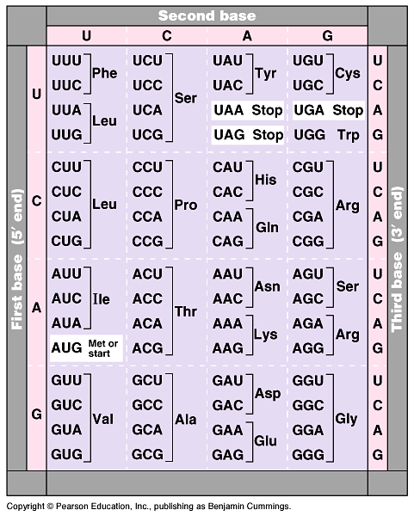
The code
Code for ALL life!
  strongest support for a common origin for all life
Code is redundant
  several codons for each amino acid
  3rd base “wobble”
Why is the
wobble good?
Start codon
  AUG
  methionine
Stop codons
  UGA, UAA, UAG
Notes:
Strong evidence for a single origin in evolutionary theory.

Slide 35
How are the codons matched to amino acids?
3′
5′
DNA
TACGCACATTTACGTACGCGG
5′
3′
mRNA
AUGCGUGUAAAUGCAUGCGCC
codon
3′
5′
UAC
GCA
tRNA
CAU
anti-codon
Met
amino
acid
Arg
Val

Slide 36
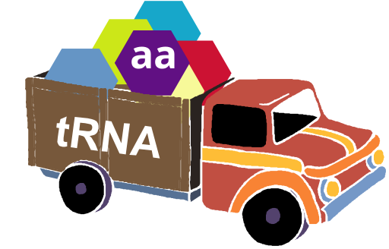
From gene to protein
aa
aa
nucleus
cytoplasm
aa
aa
aa
aa
transcription
translation
aa
DNA
mRNA
protein
aa
aa
aa
aa
ribosome
trait

Slide 37
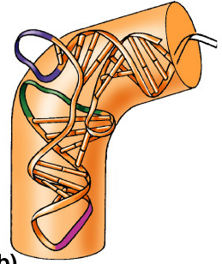
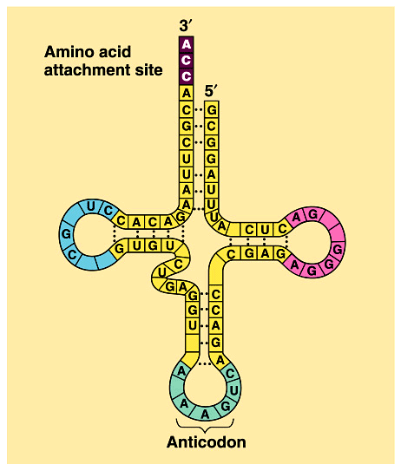
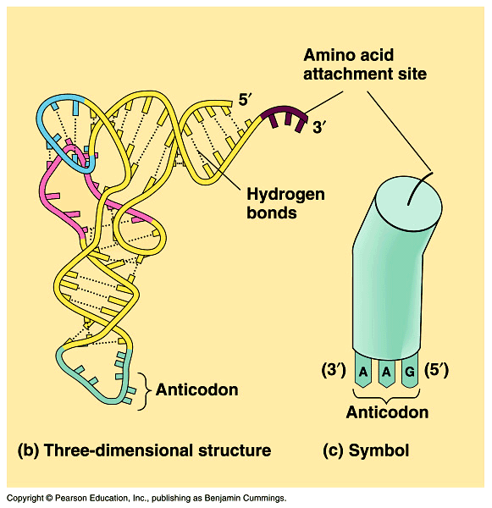
Transfer RNA structure
“Clover leaf” structure
  anticodon on “clover leaf” end
  amino acid attached on 3′ end

Slide 38
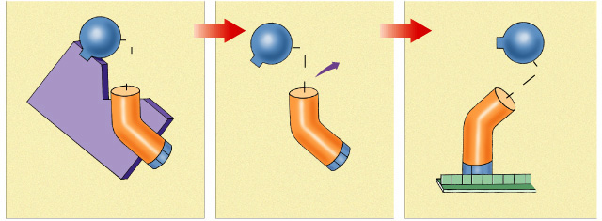
Loading tRNA
Aminoacyl tRNA synthetase
  enzyme which bonds amino acid to tRNA
  bond requires energy
    ATP → AMP
    bond is unstable
    so it can release amino acid at ribosome easily
Trp
C=O
Trp
C=O
Trp
OH
H₂O
OH
O
C=O
activating
enzyme
O
tRNA^{Trp}
A
C
C
anticodon
tryptophan attached to tRNA^{Trp}
U
G
G
mRNA
tRNA^{Trp} binds to UGG condon of mRNA
Notes:
The tRNA-amino acid bond is unstable. This makes it easy for the tRNA to later give up the amino acid to a growing polypeptide chain in a ribosome.

Slide 39
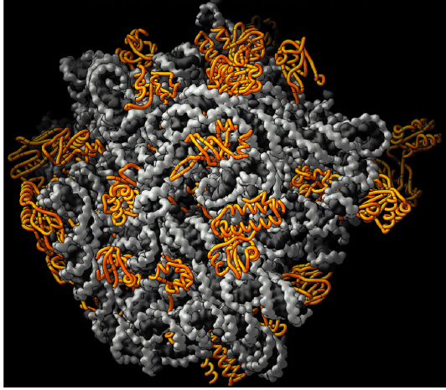
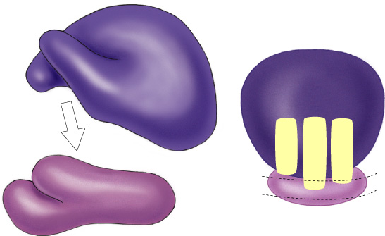
Ribosomes
Facilitate coupling of
tRNA anticodon to
mRNA codon
  organelle or enzyme?
Structure
  ribosomal RNA (rRNA) & proteins
  2 subunits
    large
    small
E
P
A

Slide 40
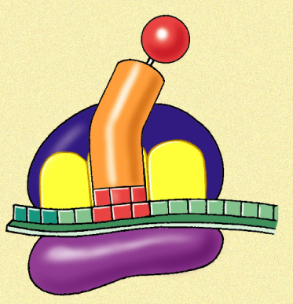
Ribosomes
A site (aminoacyl-tRNA site)
  holds tRNA carrying next amino acid to be added to chain
P site (peptidyl-tRNA site)
  holds tRNA carrying growing polypeptide chain
E site (exit site)
  empty tRNA
  leaves ribosome
  from exit site
Met
5'
U
A
C
A
U
G
E
P
A
3'

Slide 41
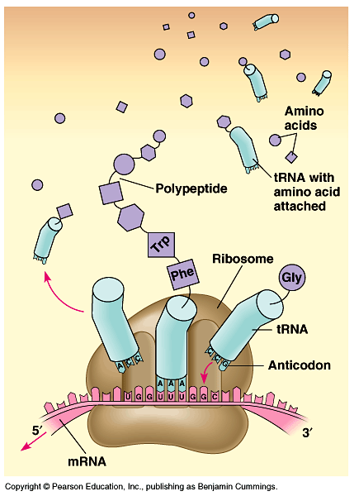
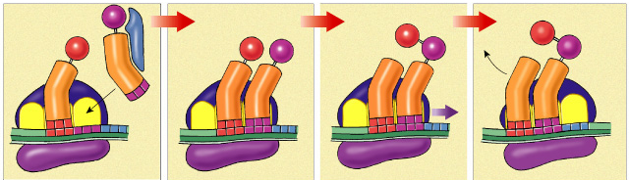
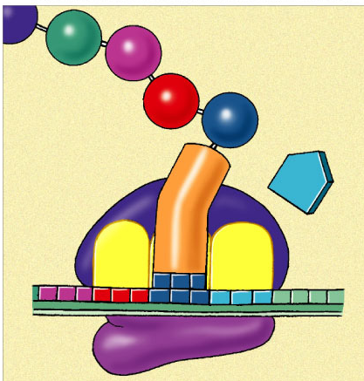
Building a polypeptide
Initiation
  brings together mRNA, ribosome subunits, initiator tRNA
Elongation
  adding amino acids based on codon sequence
Termination
  end codon
3
2
1
Leu
Val
Ser
release
factor
Met
Met
Ala
Met
Met
Leu
Leu
Leu
Trp
tRNA
A
C
G
U
A
C
U
A
C
G
A
C
U
A
C
G
A
C
A
U
A
C
G
A
C
U
5'
A
U
G
C
U
G
A
A
U
5'
A
U
G
C
U
G
A
A
U
5'
A
U
G
C
U
G
A
U
5'
A
U
G
C
U
G
A
A
3'
A
C
C
mRNA
3'
3'
3'
U
G
G
U
A
A
3'
E
P
A

Slide 42
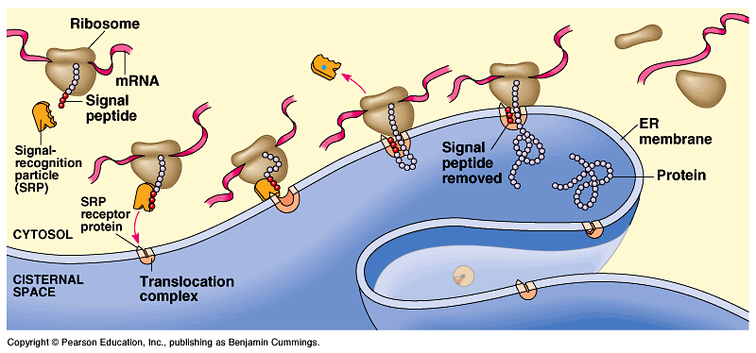
Protein targeting
Destinations:
  secretion
  nucleus
  mitochondria
  chloroplasts
  cell membrane
  cytoplasm
  etc…
Signal peptide
  address label
start of a secretory pathway

Slide 43
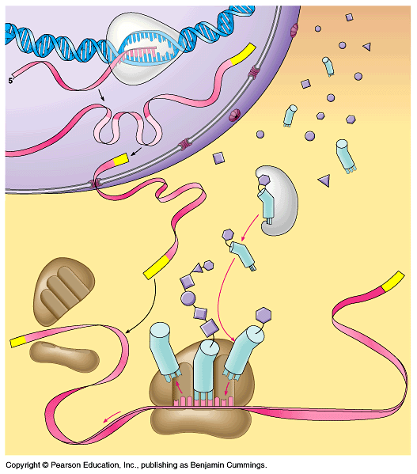
RNA polymerase
DNA
Can you tell the story?
amino
acids
exon
intron
tRNA
pre-mRNA
5' GTP cap
mature mRNA
aminoacyl tRNA
synthetase
poly-A tail
large ribosomal subunit
3'
polypeptide
5'
tRNA
small ribosomal subunit
E
P
A
ribosome

Slide 44
The Transcriptional unit (gene?)
enhancer
translation
start
translation
stop
1000⁺b
exons
20-30b
transcriptional unit (gene)
TAC
ACT
RNA
polymerase
TATA
DNA
DNA
UTR
UTR
introns
promoter
transcription
start
transcription
stop
5'
3'
pre-mRNA
5'
3'
GTP
mature mRNA
AAAAAAAA

Slide 45
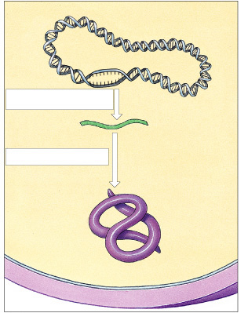
Protein Synthesis in Prokaryotes
Bacterial chromosome
Transcription
mRNA
Psssst…
no nucleus!
Cell
membrane
Cell wall
2007-2008

Slide 46
Prokaryote vs. Eukaryote genes
Prokaryotes
  DNA in cytoplasm
  circular chromosome
  naked DNA
  no introns
Eukaryotes
  DNA in nucleus
  linear chromosomes
  DNA wound on histone proteins
  introns vs. exons
introns
come out!
intron = noncoding (inbetween) sequence
eukaryotic
DNA
exon = coding (expressed) sequence
Notes:
Walter Gilbert hypothesis:
Maybe exons are functional units and introns make it easier for them to recombine, so as to produce new proteins with new properties through new combinations of domains.
Introns give a large area for cutting genes and joining together the pieces without damaging the coding region of the gene…. patching genes together does not have to be so precise.

Slide 47
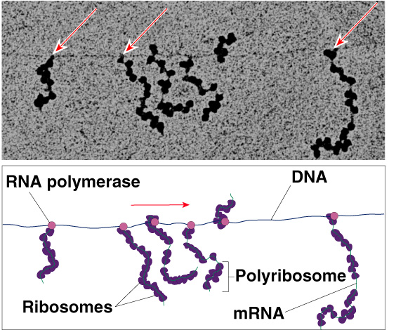
Translation in Prokaryotes
Transcription & translation are simultaneous in bacteria
  DNA is in
  cytoplasm
  no mRNA
  editing
  ribosomes
  read mRNA
  as it is being
  transcribed

Slide 48
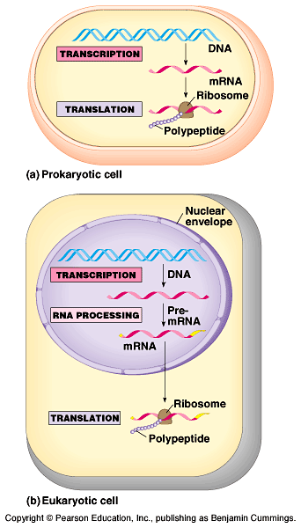
Translation: prokaryotes vs. eukaryotes
Differences between prokaryotes & eukaryotes
  time & physical separation between processes
    takes eukaryote ~1 hour
    from DNA to protein
  no RNA processing

Slide 49
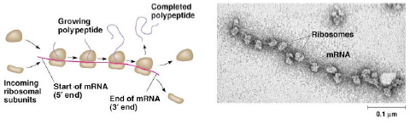
COMPLETING PROTEINS
POLYRIBOSOMES (POLYSOMES)
  Numerous ribosomes translate same mRNA at same time
  3-D folding (1’, 2’, 3’ structure)
  Chaparonins

Slide 50
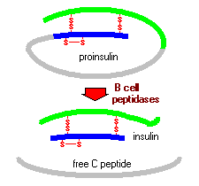
POST-TRANSLATIONAL MODIFICATIONS
  Some amino acids modified by addition of
  sugars, lipids, phosphate groups, etc
  Enzymes can modify ends, cleave into pieces
  join polypeptide strands (4’ structure)
Ex: Made as proinsulin
then cut
Final insulin hormone
made of two chains
connected by
disulfide bridges
http://www.vivo.colostate.edu/hbooks/pathphys/endocrine/pancreas/insulin.html

Slide 51
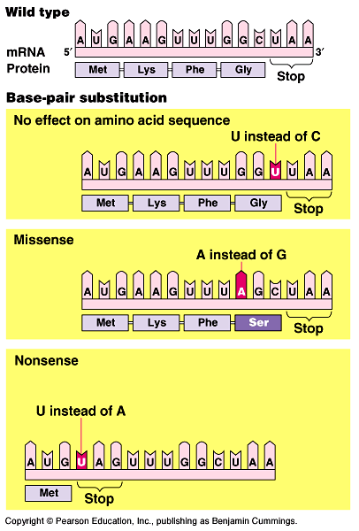
Mutations
Point mutations
  single base change
  base-pair substitution
    silent mutation
      no amino acid change
      redundancy in code
    missense
      change amino acid
    nonsense
      change to stop codon
Slide from Explore Biology by Kim Foglia

Slide 52
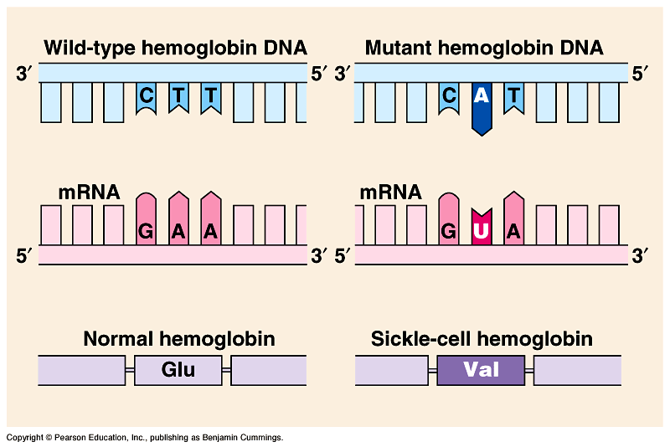
Point mutation leads to Sickle cell anemia
What kind of mutation?
Slide from Explore Biology by Kim Foglia

Slide 53
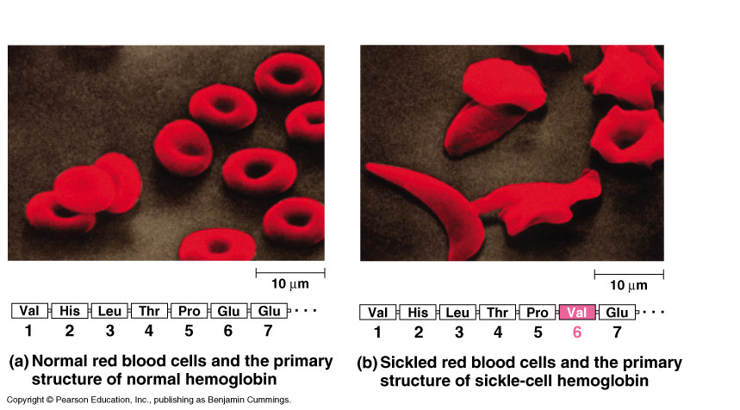
Sickle cell anemia
Slide from Explore Biology by Kim Foglia

Slide 54
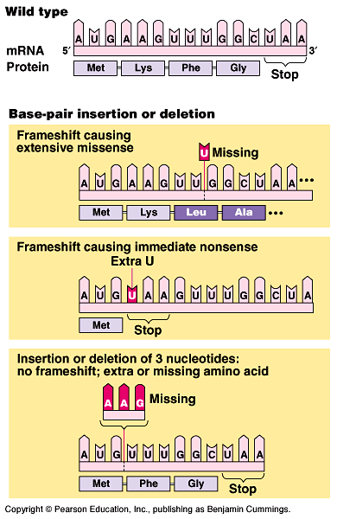
Mutations
Frameshift
  shift in the reading frame
    changes everything “downstream”
  insertions
    adding base(s)
  deletions
    losing base(s)
  More damaging at
  beginning of gene than at end
Slide modified from: Explore Biology by Kim Foglia

Slide 55
DNA → DNA ____________
DNA → RNA ____________
RNA→ Protein ___________

Slide 56
Can you tell the story?

